Slide 1


Data Visualization Through Their Graph Representation
Weber, Huang
GIDS TMU

Slide 2
Summary
Visual data mining techniques have proven to be of particularly high value in exploratory data analysis, as indicated by there search in this area.
In this chapter, we focus on the visual exploration of data through their graph representations.

Slide 3
Outline
Data and Graphs
Graph Layout Techniques
Force-directed Techniques
Multi-dimensional Scaling
The Pulling Under Constraints Model
Bipartite Graphs
Discussion and Concluding Remarks

Slide 4


Graphs are useful entities since they can represent relationships between sets of objects
Data and Graphs
Graph Layout Techniques
Force-directed Techniques
Multi-dimensional Scaling
The Pulling Under Constraints Model
Bipartite Graphs
Discussion and Concluding Remarks
Object
Object
Object
Object

Slide 5
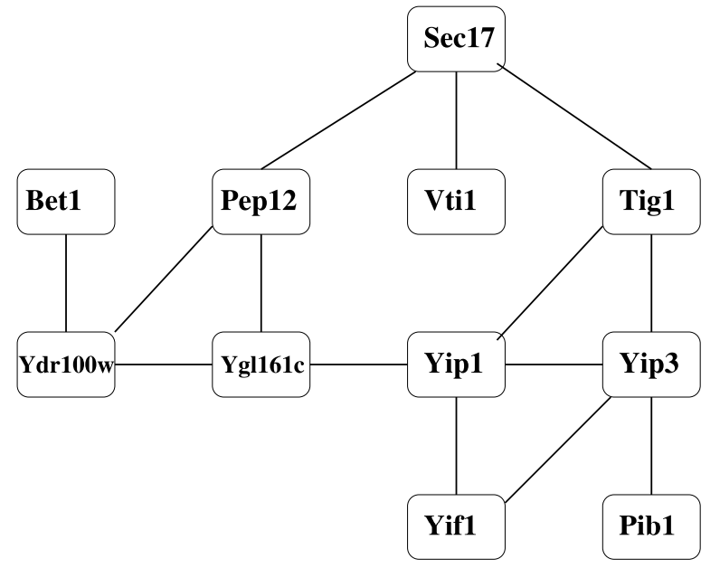
Example(1/3) Protein interaction network
Data and Graphs
Graph Layout Techniques
Force-directed Techniques
Multi-dimensional Scaling
The Pulling Under Constraints Model
Bipartite Graphs
Discussion and Concluding Remarks

Slide 6
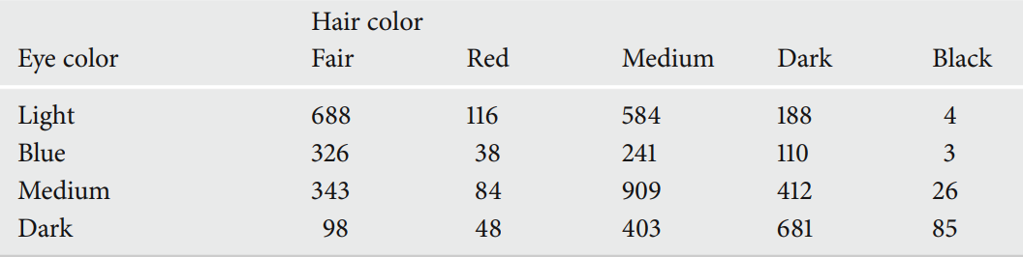
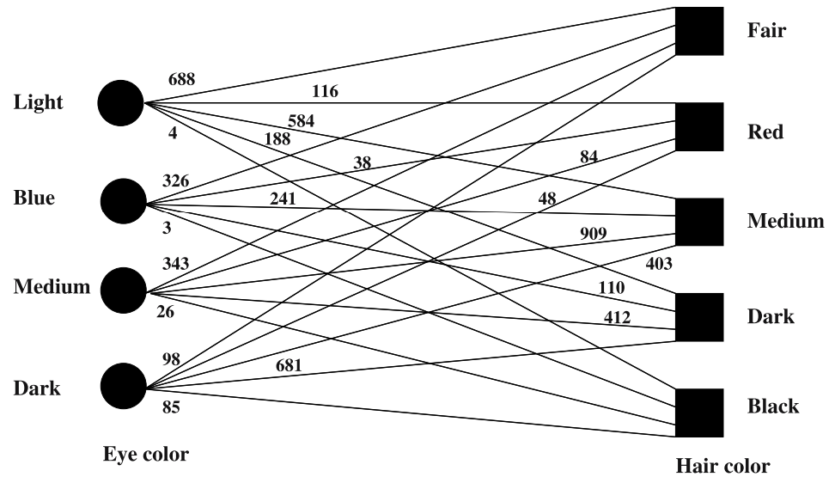
Example(2/3) Contingency table
Data and Graphs
Graph Layout Techniques
Force-directed Techniques
Multi-dimensional Scaling
The Pulling Under Constraints Model
Bipartite Graphs
Discussion and Concluding Remarks

Slide 7
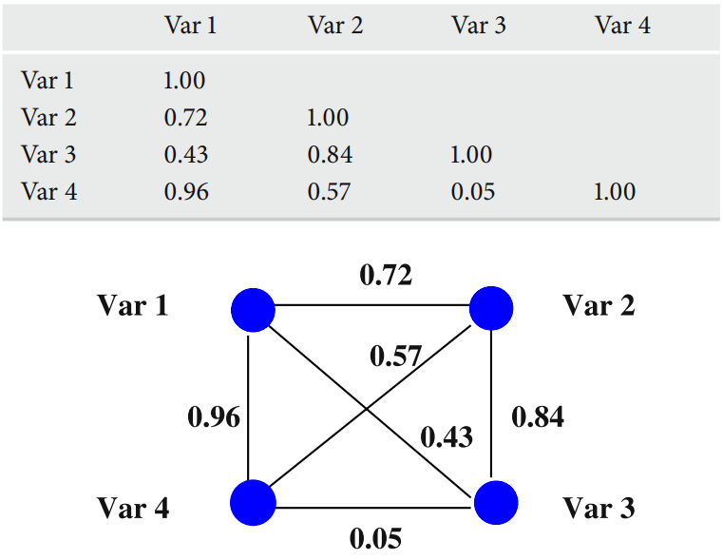
Example(3/3) Correlation matrix
Data and Graphs
Graph Layout Techniques
Force-directed Techniques
Multi-dimensional Scaling
The Pulling Under Constraints Model
Bipartite Graphs
Discussion and Concluding Remarks

Slide 8
Graph drawing/layout identification and rules (1/2)
Data and Graphs
Graph Layout Techniques
Force-directed Techniques
Multi-dimensional Scaling
The Pulling Under Constraints Model
Bipartite Graphs
Discussion and Concluding Remarks
Given a set of nodes connected by a set of edges, identify the positions of the nodes in some space and calculate the curves that connect them.
Many layout algorithms are based on a set of aesthetic rules that the drawing needs to adhere to :
Nodes and edges must be evenly distributed
Edges should have similar lengths
Edge crossings must be kept to a minimum

Slide 9
Graph drawing/layout identification and rules (2/2)
Data and Graphs
Graph Layout Techniques
Force-directed Techniques
Multi-dimensional Scaling
The Pulling Under Constraints Model
Bipartite Graphs
Discussion and Concluding Remarks
Represent the edges of a graph as points in Rp and the vertices as lines connecting the points.
metric or embedding

Slide 10
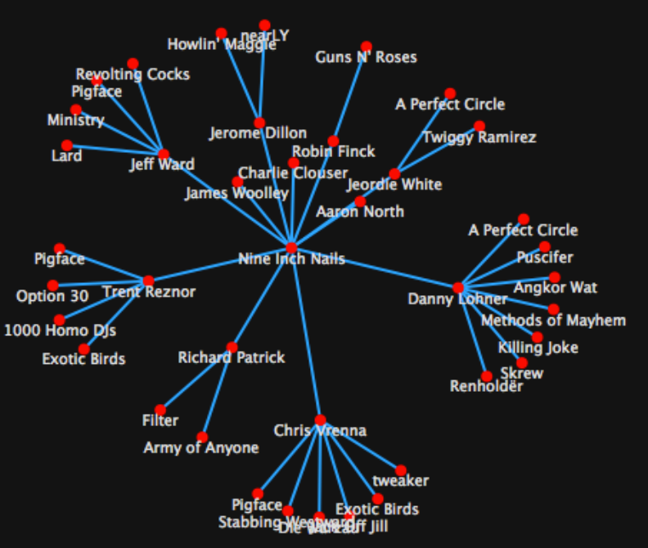
Force-directed Techniques
Data and Graphs
Graph Layout Techniques
Force-directed Techniques
Multi-dimensional Scaling
The Pulling Under Constraints Model
Bipartite Graphs
Discussion and Concluding Remarks

Slide 11
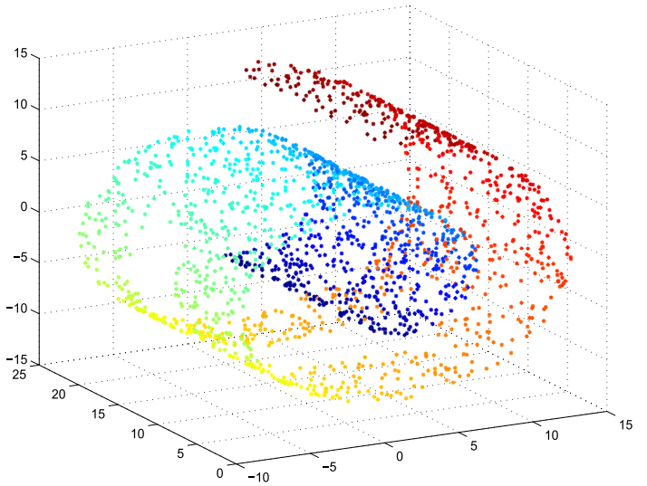
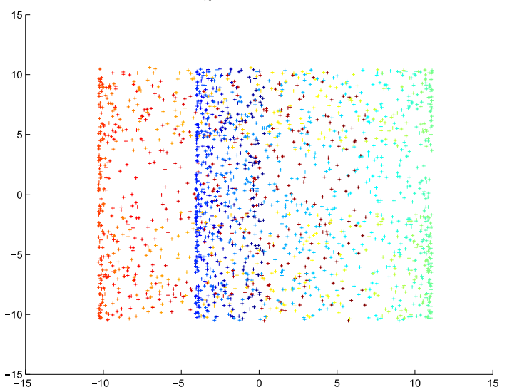
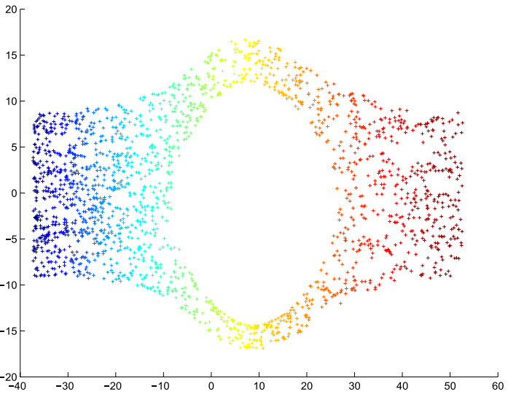
Multidimensional Scaling
Data and Graphs
Graph Layout Techniques
Force-directed Techniques
Multi-dimensional Scaling
The Pulling Under Constraints Model
Bipartite Graphs
Discussion and Concluding Remarks

Slide 12
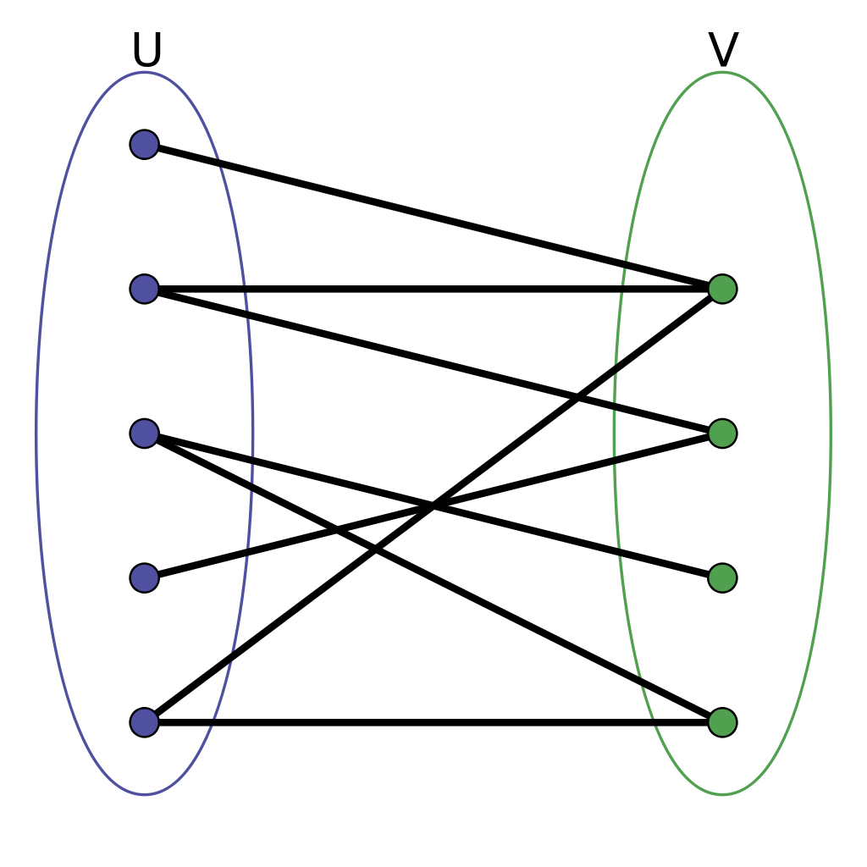
Bipartite Graphs
Data and Graphs
Graph Layout Techniques
Force-directed Techniques
Multi-dimensional Scaling
The Pulling Under Constraints Model
Bipartite Graphs
Discussion and Concluding Remarks

Slide 13
Discussion and Concluding Remarks
Data and Graphs
Graph Layout Techniques
Force-directed Techniques
Multi-dimensional Scaling
The Pulling Under Constraints Model
Bipartite Graphs
Discussion and Concluding Remarks
In this paper
the problem of data visualization through layouts of their graph representations is considered.
A mathematical framework for graph drawing based on force-directed techniques is introduced, and several connections to well-known multivariate analysis techniques such as multidimensional scaling, correspondence, and multiple correspondence analysis are made.

Slide 14
Thanks for listening !!

